Slide 1
Health, disease, death... and geography

Slide 2
What’s geography got to do with disease and health?

Slide 3
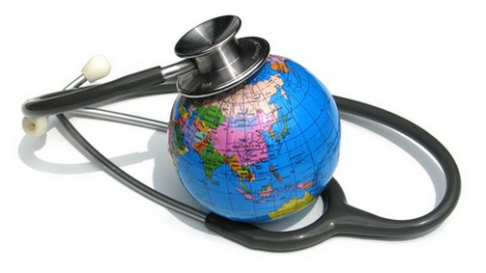
What? Where? Why?
With no spatial, map-based examination of the relationship between disease and location, we might only be effectively investigating the sociology of disease

Slide 4
Mapping disease, risk and health
patterns and relationships emerge
questions arise and
Processes become clearer
Solutions can be explored

Slide 5
Communicable and non-communicable diseases
Worldwide, one death in three is the result of an infectious disease
Almost all the deaths from infectious disease occur in the non-industrialised world.
The biggest killers in the industrialised world are non infectious diseases

Slide 6

How are infections spread?
From person to person
Through viruses, bacteria and parasites
Image of mosquito removed for copyright reasons
More than a third of the world’s population is infected with worms!

Slide 7
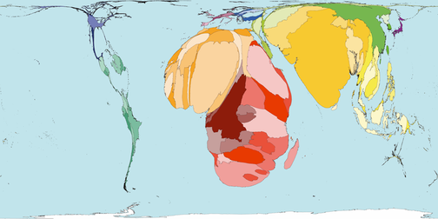
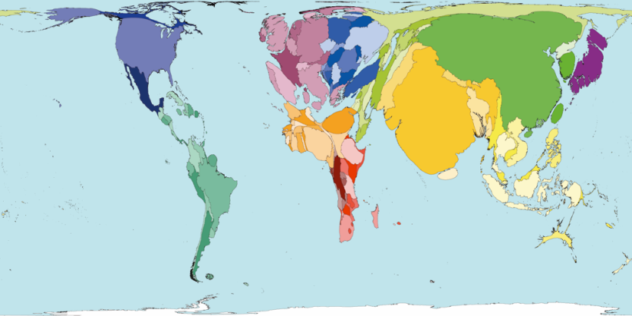
Infectious and parasitic diseases caused 19% of all deaths worldwide in 2002
WorldMapper - The maps presented on this website are equal area cartograms, otherwise known as density-equalising maps. The cartogram re-sizes each territory according to the variable being mapped.

Slide 8
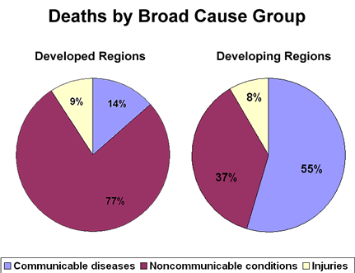
What’s going to get you?
The pie graphs show the different causes of death between developed and developing regions of the world. These areas correspond closely with the non-industrialised and industrialised parts of the world. As the graph shows, the majority of people in Developing regions die of communicable diseases, while in developed regions deaths are due largely to non-communicable diseases.

Slide 9
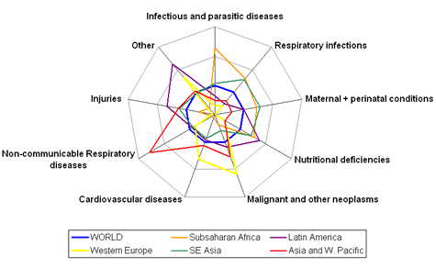
Health and Human behaviour
http://ucatlas.ucsc.edu/

Slide 10
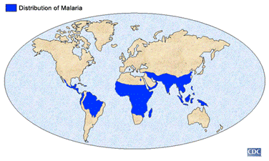
Cheryl Cole struck down with malaria: Holiday illness puts singer in hospital
Images removed for copyright reasons
Tanzania

Slide 11
Worldwide, more than 500 million people become severely ill with malaria every year. One child dies of the disease every 30 seconds.
Images removed for copyright reasons
Picture taken April 8, 2008. (Katrina Manson/Reuters)" http://timpanogos.wordpress.com/2008/11/03/beating-malaria-without-ddt/

Slide 12
Geographical Enquiry – the Challenge
Creating a sequence where pupils are building up the knowledge, understanding and skills to answer a particular enquiry question.
A question that enables the students to be aware of where they're 'going' all the way through the sequence - this helps them know why they're doing what they're doing - it is not just 'a lesson on...' but it is a journey towards solving a puzzle or constructing an answer.
A good enquiry question is engaging, making you want to answer it, and gives opportunity for careful and challenging development of those pupils' geographical learning.
What range of strategies and activities might you set up to engage your students?

Slide 13
Does poverty explain the impact of malaria in African countries?
Image removed for copyright reasons
http://malarianomore.org.uk/

Slide 14
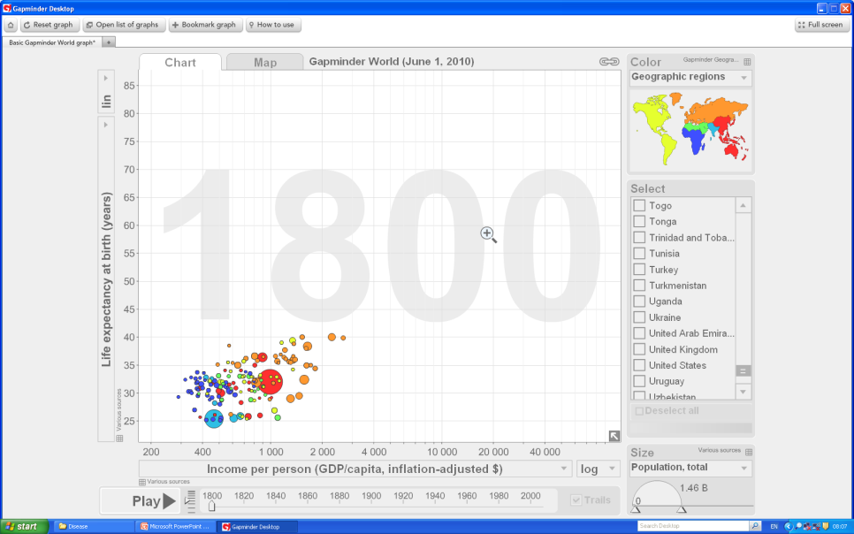

Gapminder

Slide 15
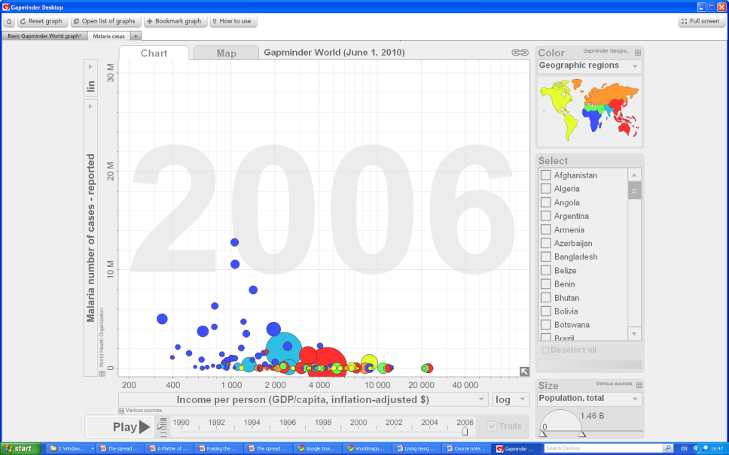
Gapminder
http://www.gapminder.org

Slide 16
Assess the reasons why the global distribution of deaths due to malaria is very uneven (15 marks)
A good essay ought to include discussion of some of the following points and make reference to named locations and specific examples.
• Refer to the geographical spread of malaria .
• Show an awareness of locations where the death rate has been particularly high (e.g. sub-Saharan Africa).
• Focus on measures taken to reduce the death rate at a variety of scales – national, international and local.
• Make a judgment (to reach level 3) about the reasons for unevenness in the global distribution of deaths.

Slide 17
Starting a concept map
Concept Mapping
Concept Mapping
A named example
This is a useful skill for students to develop that can be applied to a range of situations, encouraging them to explore how different issues are linked, to think creatively and to evaluate how important each issue is.
A named example
A named example
Brief explanation
Brief explanation
Brief explanation
A key reason
A key reason
A key reason
Why does Malaria have a high impact in Africa?
You could also link the different explanations with arrows to show
how some reasons are related
A key reason
A key reason
Brief explanation
Brief explanation
A named example
A named example

Slide 18
Concept Mapping
Rich or poor
Environmental conditions/change
Lifestyles and attitudes to risk
Intervention strategies
Causes of the disease
To what extent?
Health provision
Diffusion - rate of spread
Living conditions
Profit
Climate
Education - Information and misinformation
Accessibility and communication
prejudice
Politics and religion

Slide 19
Key Reasons

Slide 20
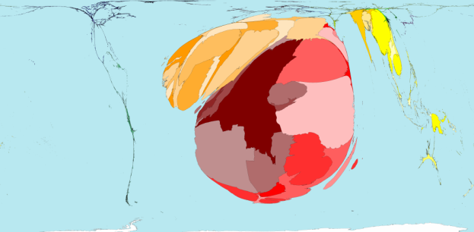
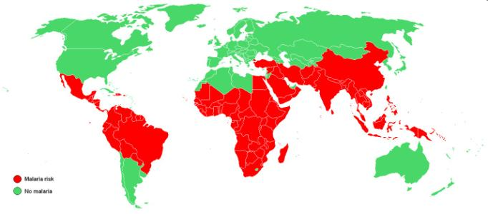
The geography of malaria
Malaria deaths
Four fifths of malaria cases are found in 13 countries
Malaria is currently endemic in 91 countries with small pockets of transmission occurring in a further eight countries. Eighty per cent of the cases occur in tropical Africa, where malaria accounts for 10% to 30% of all hospital admissions and is responsible for 15% to 25% of all deaths of children under the age of five. It is estimated that a single bout of malaria costs a sum equivalent to over 10 working days in Africa.
http://www.who.int/malaria/world_malaria_report_2010/worldmalariareport2010.pdf

Slide 21
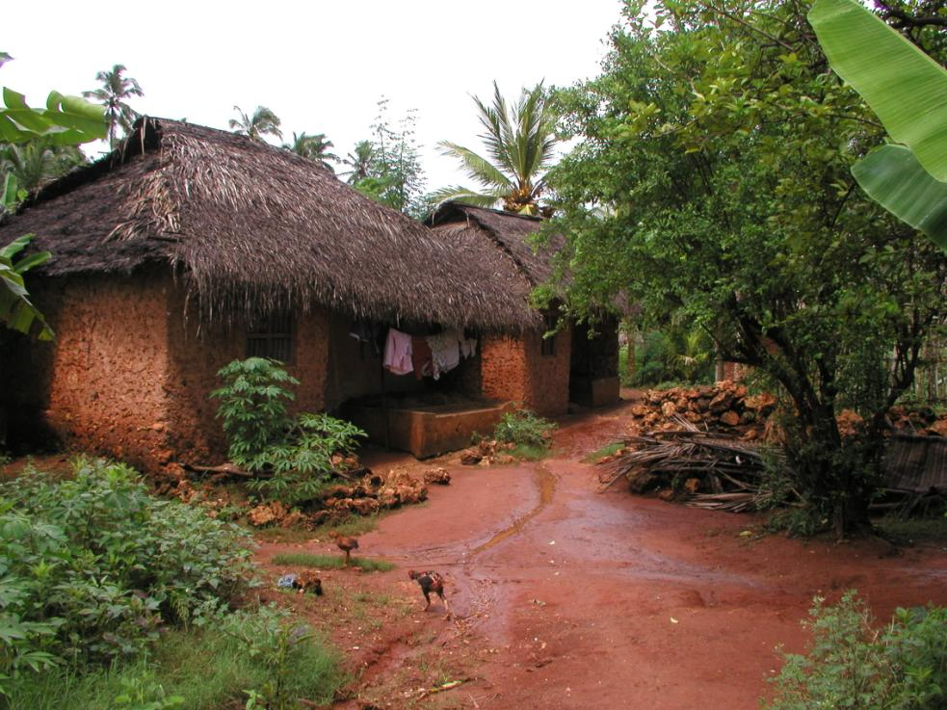
Climate
Worst affected areas;
Temperatures between 16°C and 32°C
Annual rainfall above 2000mm
Below 1500m
Location
Regions most affected are the Tropics and sub tropics. Rainforests and savanna;
Four fifths of malaria cases in 13 countries – the worst are Nigeria, Congo, Ethiopia, Tanzania and Kenya.
Some countries have seasonal outbreaks due to a rainy season – e.g. Kenya, Zambia

Slide 22
Poverty and remoteness
Malaria affects the poor and those living in rural areas more due to limited access to both prevention and treatment.
A vicious cycle of poverty continues as malaria reduces productivity and social stability. Families affected by malaria clear 60 percent less crops than those free of the disease.

Slide 23
Age
Infectious diseases disproportionately affect children and childhood death rates.
A baby girl born in Sub-Saharan Africa faces a 22 per cent risk of death before age 15. (In Industrialized countries the risk is just 1.1 per cent).
Why might this be so?

Slide 24
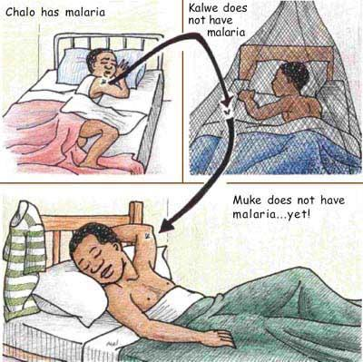
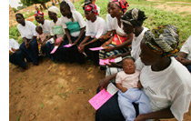
Lack of Education
PLUS - The study also showed that education must be accompanied with financial support. The most common reasons for non-use of Insecticide treated nets (ITNs) were their expense and lack of local availability.
Education is vital to malaria prevention. Between 2003 and 2006 GSK funded the NGO Freedom from Hunger project in West Africa, enabling it to bring financial services and education to poor women in West Africa.
Zambian Basic Education Course, NUTRITION EDUCATION, Supplementary Material

Slide 25
Lack of health workers
Botswana - received funding from the Clinton foundation as well as global fund for developing countries, and so had all the funding it needed to tackle the 280,000 cases needing treatment. However, only 82,000 people received the necessary drugs.
The reason? There are so few health workers there. Most of them are recruited by South Africa and the UK.

Slide 26
Remoteness and inaccessibility
Zimbabwe's province of Matabeleland North -
The decaying road infrastructure prevented anti-malaria spraying teams from reaching the area, and is being blamed for an outbreak of the disease.

Slide 27
Counterfeit drugs
Fake anti-malarial drugs are an increasingly serious problem, particularly in South-East Asia and Africa. In countries with a large burden of malaria, such as Myanmar (Burma), the Lao PDR, Cambodia and Viet Nam, as many as half of all artesunate tablets -- one of the most effective anti-malarial drugs -- is counterfeit.

Slide 28
Pharmaceutical companies attitudes
Little investment in diseases where there is little return
Only worthwhile if people from wealthy countries are affected

Slide 29
Lack of funding
It is estimated that $5 billion would be needed each year to effectively control malaria. Only about $1.7 billion is given by malaria endemic country governments, donor governments, and UN agencies per year towards this cause.

Slide 30
Politics?
The Global Fund to Fight Aids, Tuberculosis and Malaria froze its donations to Zimbabwe in 2008 after President Mugabe's central bank was found to have pilfered £4.5 million from funds meant to combat disease.

Slide 31
War
The Second Congo War (1998-2003) was the largest war in modern African history, involving eight African nations. By 2008 the war and its aftermath had killed 5.4 million people, mostly from disease and starvation.
The Democratic Republic of Congo accounts for 11% of all the malaria cases in Africa.
The aftermath of war, poverty and lack of resources in the Congo prevents the creation of a malaria control program.
Image removed for copyright reasons
A Rwandan soldier carries his weapon through the village of Pinga in eastern Congo.
Photograph: Finbarr O'Reilly/Reuters

Slide 32
Curriculum Making
How does this take the learner beyond what they already know?
Learning Activity
Student Experiences
Teacher Choices
Geography: the subject
Underpinned by Key Concepts
Thinking Geographically
Notes:
the creation of interesting, engaging and challenging educational experiences appropriate to the context of the learning and teaching’
It is Creative
- engagement v delivery
- leading v following
It is Responsive
- to young people’s interests/needs
- to events and real world issues
- to the changing subject
It is the creative act of interpreting a curriculum specification
Turning it in to a coherent scheme of work
This then needs to be resourced and developed into lesson experiences
The new flexible KS3 programmes of study allow teachers to be curriculum makers

Slide 33
Your Turn.....
Key Questions
What would be your key question(s)?
Learning Objectives
What would be your learning objectives?
Structuring the learning
What strategies might you use to develop the enquiry sequence and build a concept map?
What other information do you need?

Slide 34
Obesity
Would you feel comfortable tackling this issue in geography lessons at school?
Image removed for copyright reasons
Image from; http://tinyurl.com/254dgtp

Slide 35
Starting a concept map
Concept Mapping
Concept Mapping
A named example
A named example
A named example
Brief explanation
Brief explanation
Brief explanation
A key reason
A key reason
A key reason
Obesity – A disease of the rich?
You could also link the different explanations with arrows to show
how some reasons are related
A key reason
A key reason
Brief explanation
Brief explanation
A named example
A named example

Slide 36
Your Turn..... How would you approach obesity?
Key Questions
What would be your key question(s)?
Learning Objectives
What would be your learning objectives?
Structuring the learning
What strategies might you use to develop the enquiry sequence and build a concept map? Address global/regional/local distributions/differences? Sensitivities?
What other information do you need?

Slide 37
Reflections.......

Slide 38


Top Spec Geography: Health Issues in Geography
Dan Cowling and Bob Digby
Key Stage: P16
ISBN: 978-1-84377-252-1
Published: 2010
Price to members: £14.99
Further resources.......
Living Geography: Exciting futures for teachers and students
David Mitchell

